Slide 1
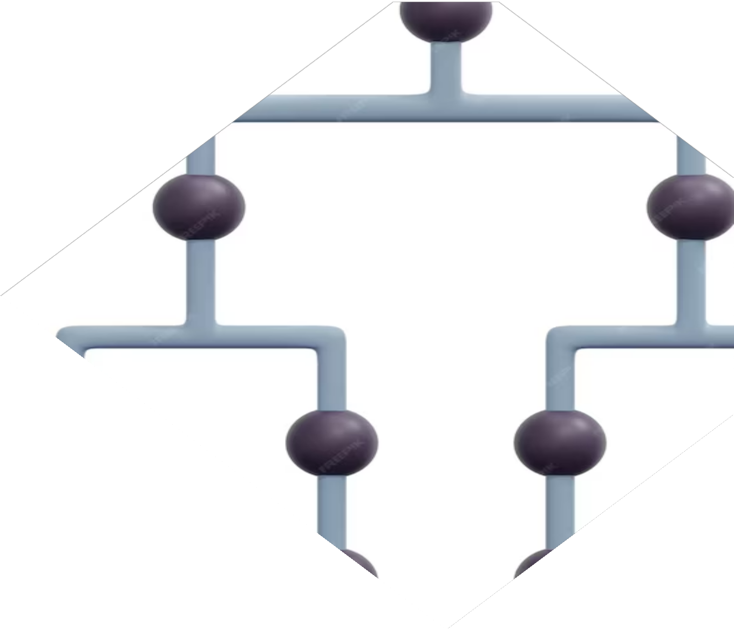
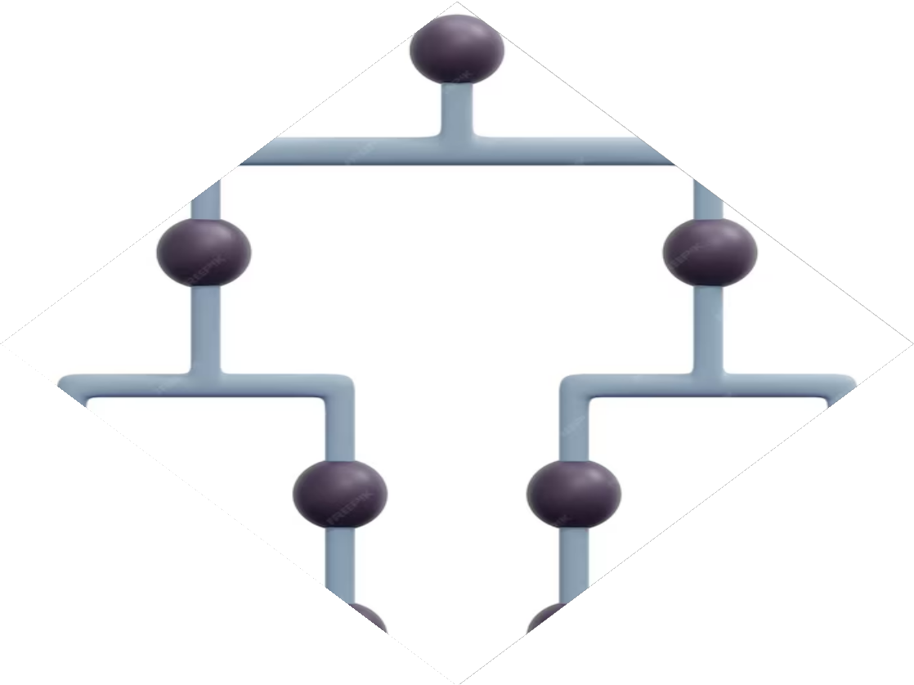
Exploring the Siamese Network: Unveiling its Applications and Potential

Slide 2









Introduction
is a deep learning architecture that has gained signiﬁcant attention due to its remarkable performance in various applications. This
presentation explores the
and of Siamese Networks. We will delve into its utilization in
,
,
, and more.

Slide 3









Image Recognition
Siamese Networks excel in tasks by learning
. By comparing the
of
images, they can accurately classify and identify similar objects or scenes. This makes them valuable in
,
, and applications.

Slide 4
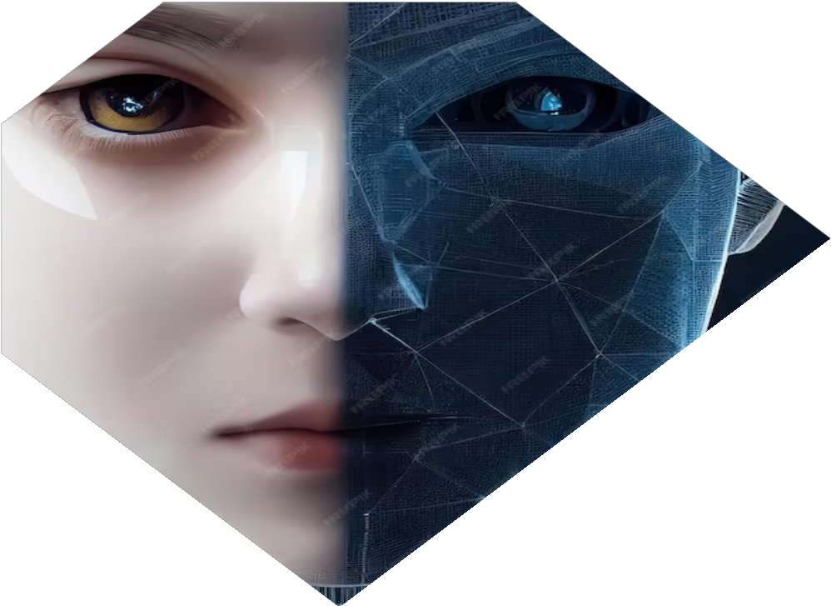





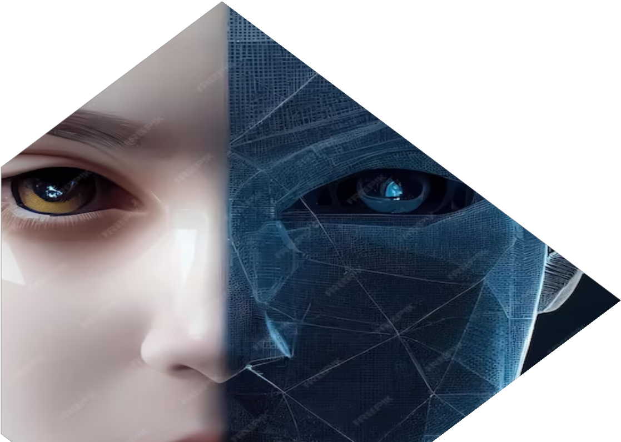

Face Verification
In the
, Siamese Networks compare of two face images to
determine if they belong to the same person.
This enables robust systems that can be used for ,
,
and . Siamese Networks handle variations in pose, lighting, and expression effectively.

Slide 5






Signature Verification
Siamese Networks can also be applied to
. By analyzing the
of two signature images, they can
authenticate the identity of the signer. This is useful in , , and
. Siamese Networks capture
distinctive features and patterns in signatures for accurate comparisons.

Slide 6






Text Similarity
Siamese Networks are not limited to visual tasks. They can be used for measuring as well. By encoding textual data into , Siamese Networks can determine the semantic similarity between two pieces
of text. This is valuable in
,
, and
.

Slide 7







Time Series Analysis
Siamese Networks can also be leveraged for
. By comparing the
of two time series data, they can identify patterns, detect anomalies, and
perform applications in
, and
. This ﬁnds
,
.

Slide 8




Recommendation Systems
Siamese Networks contribute to
by capturing
and . By
learning embeddings of users and items, they can provide personalized recommendations for products, movies, music, and more. Siamese Networks
enhance
and for businesses.

Slide 9






Advantages of Siamese Networks
Siamese Networks offer several advantages. They are to variations in input data,
effectively, and can learn
. They are also useful in scenarios and can be combined
with other architectures for improved performance.

Slide 10
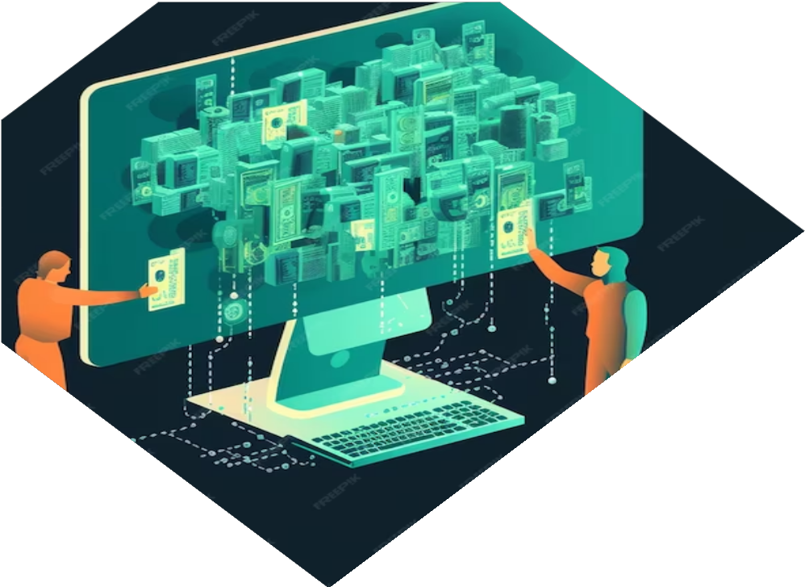




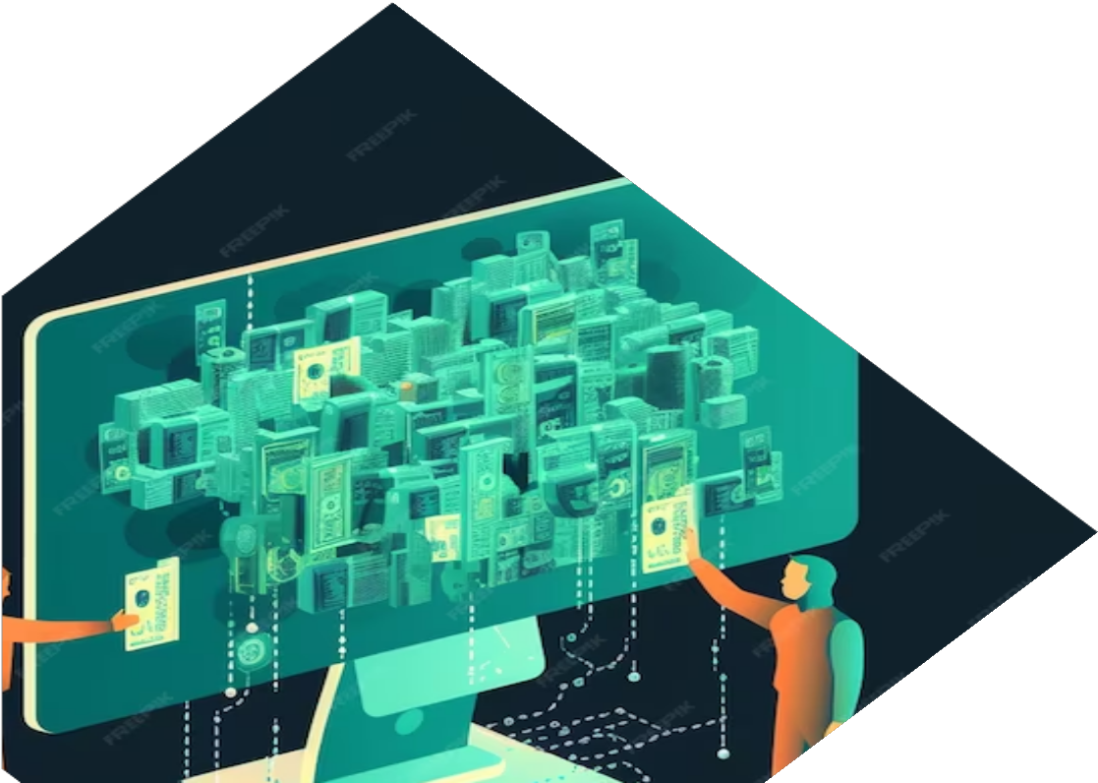

Challenges and Future Directions
While Siamese Networks have shown great promise, there are challenges to address.
,
, and are
areas that need further exploration. Future directions include
, and
,
.

Slide 11





Applications in Healthcare
Siamese Networks have immense potential in healthcare. They can aid in
,
,
and . By comparing
medical data, Siamese Networks can assist in of abnormalities and provide personalized treatment recommendations.

Slide 12





Applications in Finance
Siamese Networks ﬁnd applications in ﬁnance, such as ,
, and . By
analyzing historical data, Siamese Networks can identify fraudulent patterns, predict creditworthiness, and make informed trading decisions.

Slide 13







Conclusion
Siamese Networks have emerged as a powerful tool for various applications. Their ability to learn
and handle
like ,
makes them valuable in domains
,
,
,
, ,
and more. As research progresses, Siamese Networks will continue to unlock new possibilities and advancements.

Slide 14
Thanks!
Do you have any questions?
addyouremail@freepik.com
+91 620 421 838
yourwebsite.com

